Slide 1
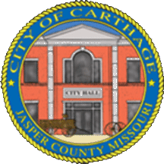
State of the City
Carthage, Missouri, FY 2023
As of November 4th, 2022

Slide 2
WELCOME
Julie Reams: President/CEO
Carthage Chamber of Commerce

Slide 3
THE MISSION OF THE CITY OF CARTHAGE
To provide and maintain essential, quality public services that meet the collective basic needs of our residents in a cost effective, responsive, and professional manner given the changing needs and resources available and to identify and seize opportunities for a higher quality of life, while protecting our legacy and maintaining our historical sense of community values.

Slide 4
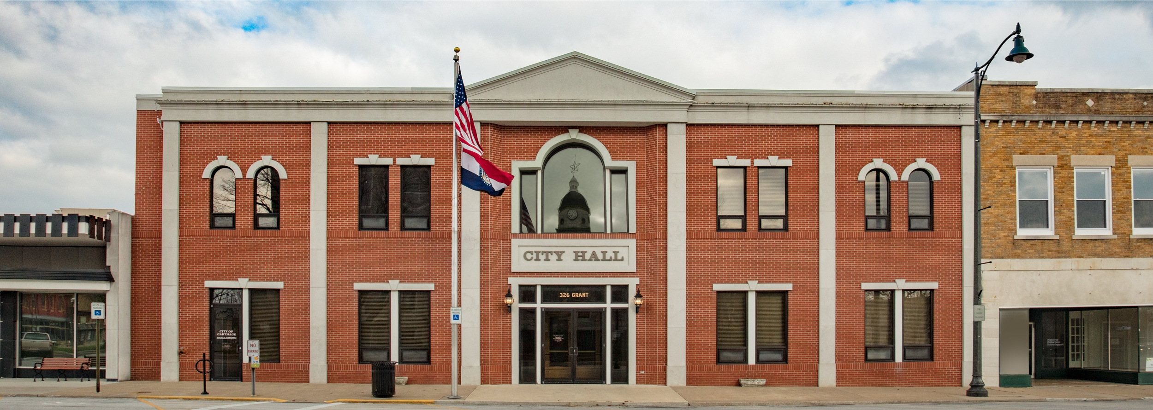
THE CITY STRUCTURE
The City Charter defines Carthage as a “Mayor Strong” city government with an elected Mayor and 10 Council members, two from each geographical district. 6 Council Members were newly elected or appointed this year.

Slide 5
NUMBER OF EMPLOYEES BY DEPARTMENT
Administration: 7 FT, 1 PT
Info Tech: 2 FT
Attorney: 1 FT*
Civil War Museum: 2 PT
Memorial Hall: 1 FT, 5 PT
Court: 2 FT, 1 PT
Public Works: 7 FT
Recycling Center: 2 FT
Street: 19 FT
Police: 37 FT, 11 PT
Taxi: 5 PT
Fire: 27 FT
Parks: 6 FT, 4 PT
Golf: 5 FT, 16 PT
Total: 116 FT, 45 PT
*New Position of Full time city attorney added
We are at over 91% Staffing Level

Slide 6
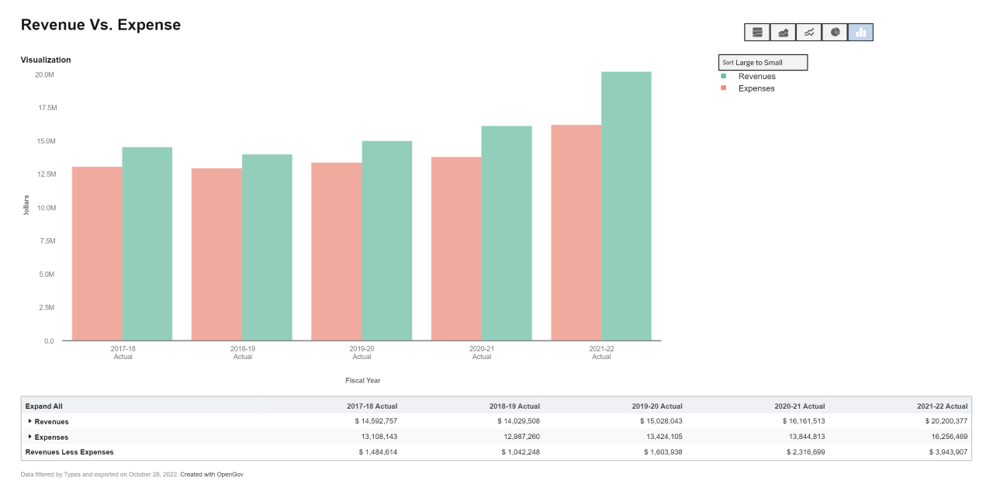
THE BUDGET
I would like to put some info about the budget for the last 5 years here. If there is something in opengov has then let’s use it. Without knowing that they have my thoughts are:
The general fund for the last five years, including this year. Budget, Revenue and Expenses.
All other tax revenue funds broken down for the last 5 years, same info especially use tax

Slide 7
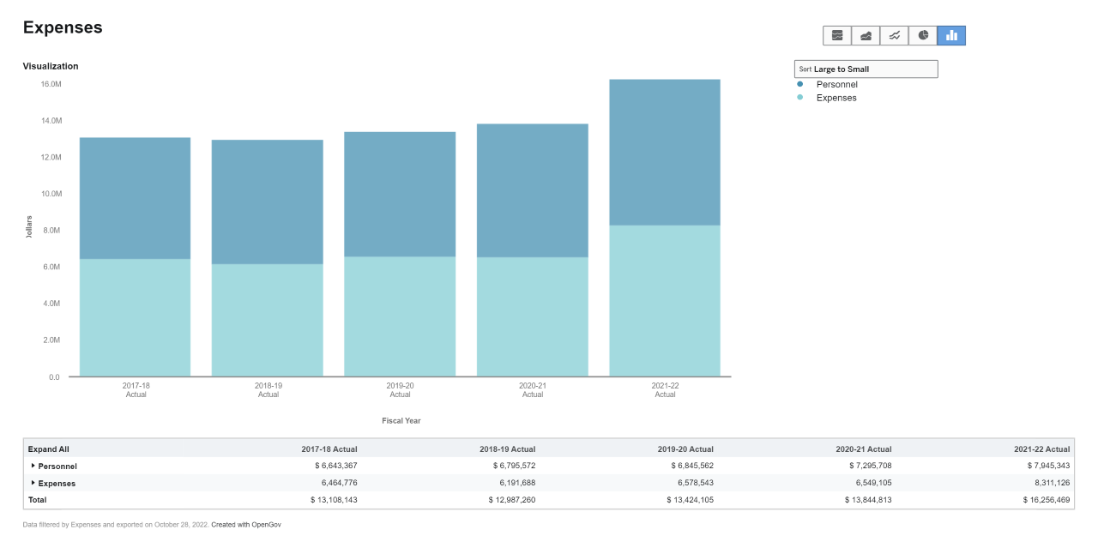
THE BUDGET

Slide 8
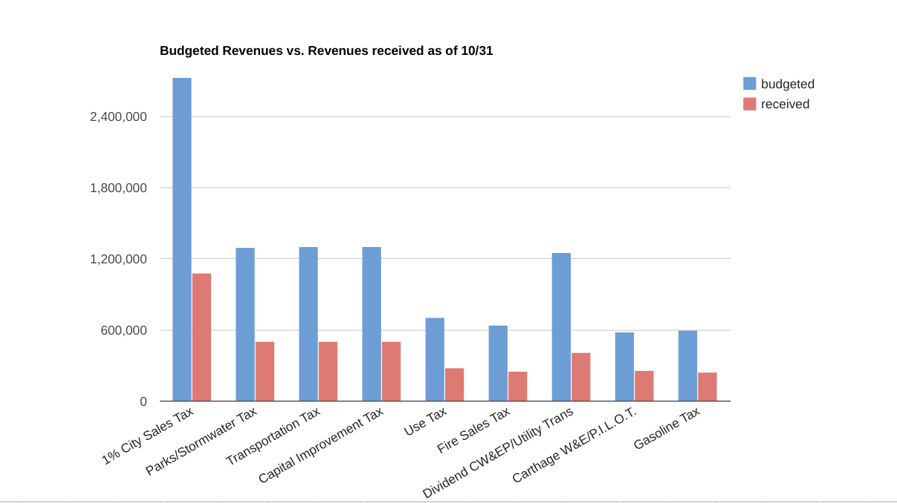
The Budget

Slide 9
CITY USE TAX
Key Facts About the August 2021 Ballot
What is a use tax? This requires out of state businesses to collect and pay the City of Carthage at the same rate as our local sales tax rate of 2.75%, this includes all online purchases that a consumer makes.
Used to fund:
40% to Parks & Recreation
30% to Public Safety
30% to Infrastructure Modernization
Allocations to be revisited in 2024
Since passed in 08/21, $862,649.47 collected

Slide 10
FY 2022 PROJECTS COMPLETED
Information Technology (IT)
Wifi Segregation
Cybersecurity Improvements (such as MFA)
Domain Consolidation
Working on Audio and Visual Improvements to Council Chambers
Public Works/Streets
Grand Avenue Milling and Overlay (Chestnut to Fairlawn)
Central Avenue Sidewalk Project (Garrison to 96 Highway)
Garrison Ave Road Widening and Stormwater Project
Fairlawn Roundabout (Partnership with MoDOT)
Hazel from Airport to HH (Road Widening and Stormwater Improvement, Schreiber Project)

Slide 11
FY 2023 CAPITAL PROJECTS
Public Works/Streets
Department
6th and Main Parking Lot (Partnership with Vision Carthage and CWEP)
Stormwater Project, Case to Macon
Case Street Bridge Replacement
Myers Park Roundabout
Police Department
New Kitchen at PD
New Fence around PD parking area
Police Take Home Vehicles for Officers
Fire Department
NFIRS (National Fire Reporting System)
Station 1 diesel exhaust system (PLYMOVENT)
New inflatable rescue boat
Station 2-yard improvements.
Purchase of Secondary Fire Gear.
These projects have been completed, or are nearing completion.

Slide 12
THE FUTURE OF THE BUDGET
Our focus:
Updating the 2009 Comprehensive Plan
Priority Based Budgeting
What does this look like?
The implementation of new financial software

Slide 13
THE PARK MASTER PLAN
In 2021 the City competed a Park Master plan to provide clarity and direction for parks, trails, programs, and facilities, as we look forward to the next 10 years. This plan was created with input from our community in the form of surveys and community forums. The complete plan is on the city website. Phase one of the plan is to update/replace/create play structures and bathrooms in existing city parks. The community sent a clear message that taking care of what we have is priority #1!
Thanks to over 5 Million Dollars provided by the McCune Brooks Trust, in partnership with the city, the engineering and planning for these projects will be done soon and hopefully in the Spring we will start to see these structures going up in the parks!

Slide 14
FUTURE PROJECTS
A grant has been obtained to replace the McGregor Street Bridge
A grant has been approved for sidewalks from Steadley Elementary to Chapel Road
A grant has been submitted to repair the three bridges on North Garrison, we should find out soon if the City will be awarded the grant,
I-49 Roundabout beginning second quarter 2023
River Street Sidewalk Project, River from Airport to Fairview beginning 1st quarter of 2023
HH and Garrison Traffic Signal to be installed in 2023
1.2 Million on asphalt overlay
**The bridges at Oak, Walnut, Sycamore, and High Streets, that span the railways, are owned by the railroad and the City can not take action to repair these at this time.

Slide 15
DOWNTOWN PARKING COMMITTEE
Added 11 Parking Spots to Downtown Parking
Jasper County has allowed 4th and Grant and 2nd and Lyon as public parking, and lots have been improved (lighting, sealing)
4 Spaces converted to 15 minute parking because of an overabundance of handicap parking spaces
Increased signage, and removal of old signage

Slide 16
TOURISM: EXPERIENCE CARTHAGE, MO
Website
Historic Homes Driving Tour
Historic Home Walking Guide
Events: We want to hear from you!
Submit events online to be featured on Website and Social Media
Food Truck Friday
Location: Inside Carthage Chamber of Commerce, 402 S Garrison, Carthage, MO 64836
Website: www.experiencecarthagemo.com
Phone Number: (417) 423-8075
Social: @ExperienceCarthageMO

Slide 17
BUILDING AND CONSTRUCTION PERMITS/CODE ENFORCEMENT
FY 22 Nuisance Abatement
895 Inspections, 355 posted, 463 were re-inspected and cleared without city intervention other than notification
FY 22 Property Maintenance
9 Buildings removed from demo list due to renovation or repair
16 buildings demolished
Total FY 22 Building Permits Issued
136 permits issued totaling $42 Million in construction within the city
616 other permits for improvements (roofing, electrical) totaling $105,000

Slide 18
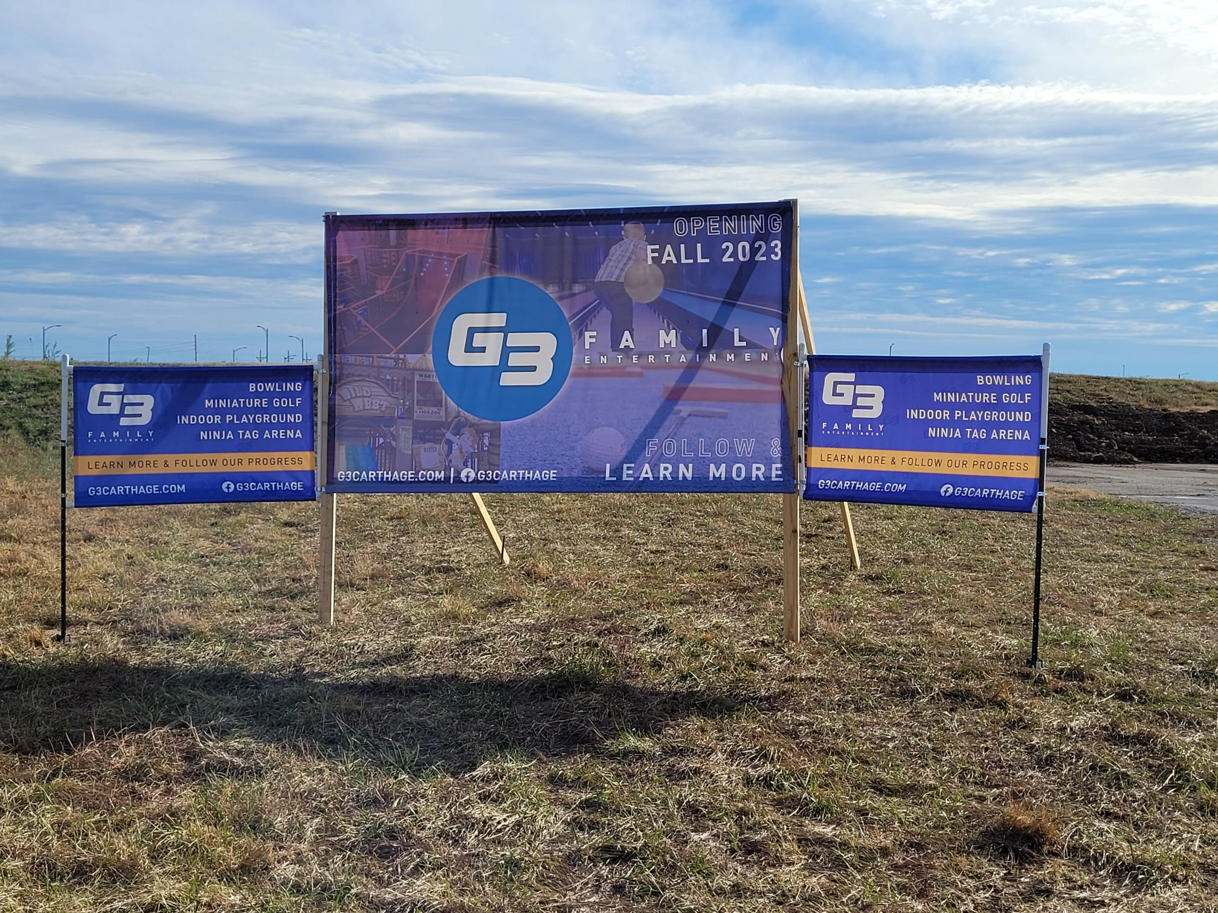
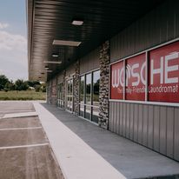
MYERS PARK
What is Myers Park?
G3 Family Entertainment Center
Wosche Laundromat and Retail
Townhouses
Other things happening with developers, more announcements to come

Slide 19
THANK YOU FOR ATTENDING

